Slide 1
MACHINE LEARNING PROJECT
Bengaluru PG Market Analysis
Segmentation and Predictive Classification of Paying-Guest Accommodations Using Unsupervised and Supervised Machine Learning
# | Member Name | Registration Number
1 | Tanishka Jain | CL20260703011712222
2 | Bhumi Paliwal | CL20260703011712020
3 | Gouri Shrimali | CL20260703011711919
4 | Mohit Mali | CL20260703011712626
Batch: TechDS01 Dataset: Final_PG_Dataset.csv (Bengaluru PG Listings)

Slide 2
PROJECT AGENDA
What We'll Cover
1
Project Objective & Workflow
6
ML Modeling — K-Means Clustering & Classification
2
Dataset Description & Screenshot
7
Model Results & Evaluation
3
Data Cleaning & Preprocessing
8
Key Insights & Business Recommendations
4
Exploratory Data Analysis (EDA)
9
Conclusion
5
Key Visualizations from the Notebook
Bengaluru PG Market Analysis
2

Slide 3
PROJECT OBJECTIVE
What This Project Sets Out To Do
Clean and standardise a raw, intentionally messy PG listings dataset — missing values, inconsistent text categories, and corrupted numeric fields — into an analysis-ready form.
Explore the dataset (EDA) to understand distributions, outliers, and relationships between rent, safety, commute, and amenities before modelling.
Segment PG listings into a small number of interpretable, business-meaningful market clusters using K-Means, choosing the cluster count via the elbow method and silhouette score.
Train and compare multiple classification models (KNN, Logistic Regression, Random Forest) to predict a listing's market segment from its features, and select the best-performing model.
Package the trained pipeline (preprocessor, clustering model, classifier) so a new PG listing's segment can be predicted instantly — the capability exposed via the Streamlit application.
Bengaluru PG Market Analysis
3

Slide 4
PROJECT WORKFLOW
End-to-End Pipeline
Data
Collection
Cleaning
EDA
Visualization
ML
Modeling
Evaluation
Insights
Each stage feeds the next: cleaned data drives EDA, EDA drives feature choices for clustering, the clustering output becomes the classification target, and evaluation results feed the final business insights.
Bengaluru PG Market Analysis
4

Slide 5
DATASET
Dataset Description
3,000
2,998
44 → 40
Raw listings
(Raw_PG_Dataset.csv)
Cleaned listings
(Final_PG_Dataset.csv)
Columns before → after
cleaning
Source & Size
Feature Groups
Raw_PG_Dataset.csv — 3,000 Bengaluru PG listings, 44 columns (after PG_ID set as index).
Final_PG_Dataset.csv — 2,998 rows × 40 columns, after dropping 4 unused columns (Zone, Sharing_Capacity, Amenities, Check_In_Date) and 2 exact duplicate rows.
For clustering & classification, 6 additional rows with an unresolvable sentinel rent value (999999) were excluded, leaving 2,992 rows for modelling.
Identity & location: PG_Name, Area, Latitude, Longitude, Pincode, Nearest_Metro, Distance_to_Metro_km, Nearest_IT_Park, Distance_to_IT_Park_km
Listing attributes: Gender, Room_Type, Food_Type, Occupancy_Status
Cost: Monthly_Rent, Security_Deposit, Electricity_Charges, Water_Charges, Maintenance_Fee
Quality signals: Google_Rating, Review_Count, Safety_Score, Commute_Score, Value_for_Money
Amenities: 14 binary Yes/No flags (WiFi, Laundry, Parking, Power_Backup, Housekeeping, Gym, Lift, CCTV, RO_Water, AC, TV, Study_Table, Geyser, Washing_Machine)
Bengaluru PG Market Analysis
5

Slide 6
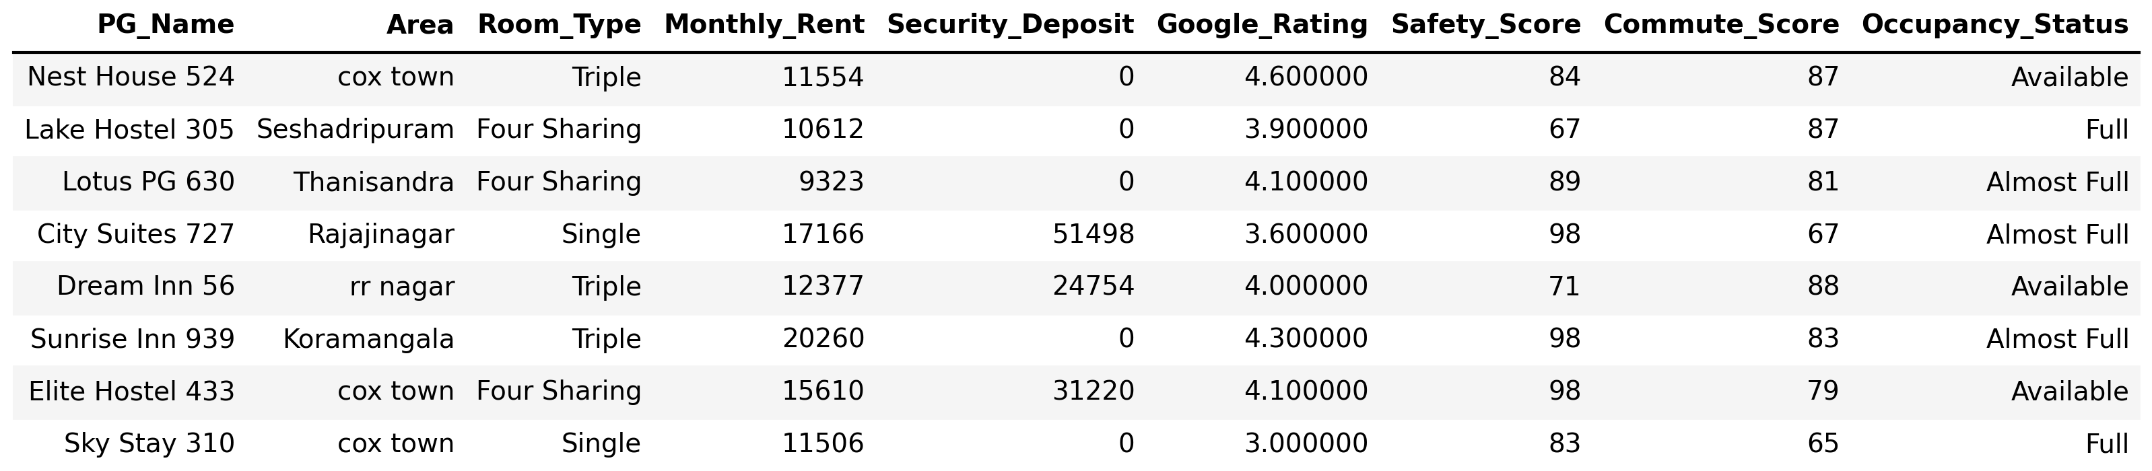
DATASET
Actual Screenshot of the Dataset
Sample rows from Final_PG_Dataset.csv (selected columns)
Columns shown: PG_Name, Area, Room_Type, Monthly_Rent, Security_Deposit, Google_Rating, Safety_Score, Commute_Score, Occupancy_Status
Full cleaned dataset: 2,998 rows × 40 columns
Bengaluru PG Market Analysis
6

Slide 7
DATA PREPARATION
Data Cleaning & Preprocessing
Dropped unused columns: Zone, Sharing_Capacity, Amenities, Check_In_Date.
Missing values: Electricity_Charges & Water_Charges → filled with 0; Food_Type & Nearest_Metro → filled with mode; Area (12 missing) → filled with mode.
Invalid Google_Rating values (outside 0–5) set to NaN, then filled with the median.
Security_Deposit text values ('Nil', '2 Months') standardised to 0; malformed Monthly_Rent values ('Rs 999999', '999999/month', '₹999999', '9,99,999', -9999) standardised to a single sentinel, 999999.
Yes/No amenity flags (14 columns) standardised from mixed representations (0/1, Y/N, yes/no, True/False) into a consistent Yes/No mapping.
Area names de-duplicated by normalising spacing/case — 310 raw category variants collapsed into 66 clean localities.
Owner_Contact cleaned to the last 10 digits; values not exactly 10 digits replaced with 'Not Available'.
2 exact duplicate rows identified and removed; cleaned data saved to Final_PG_Dataset.csv (2,998 × 40).
Bengaluru PG Market Analysis
7

Slide 8
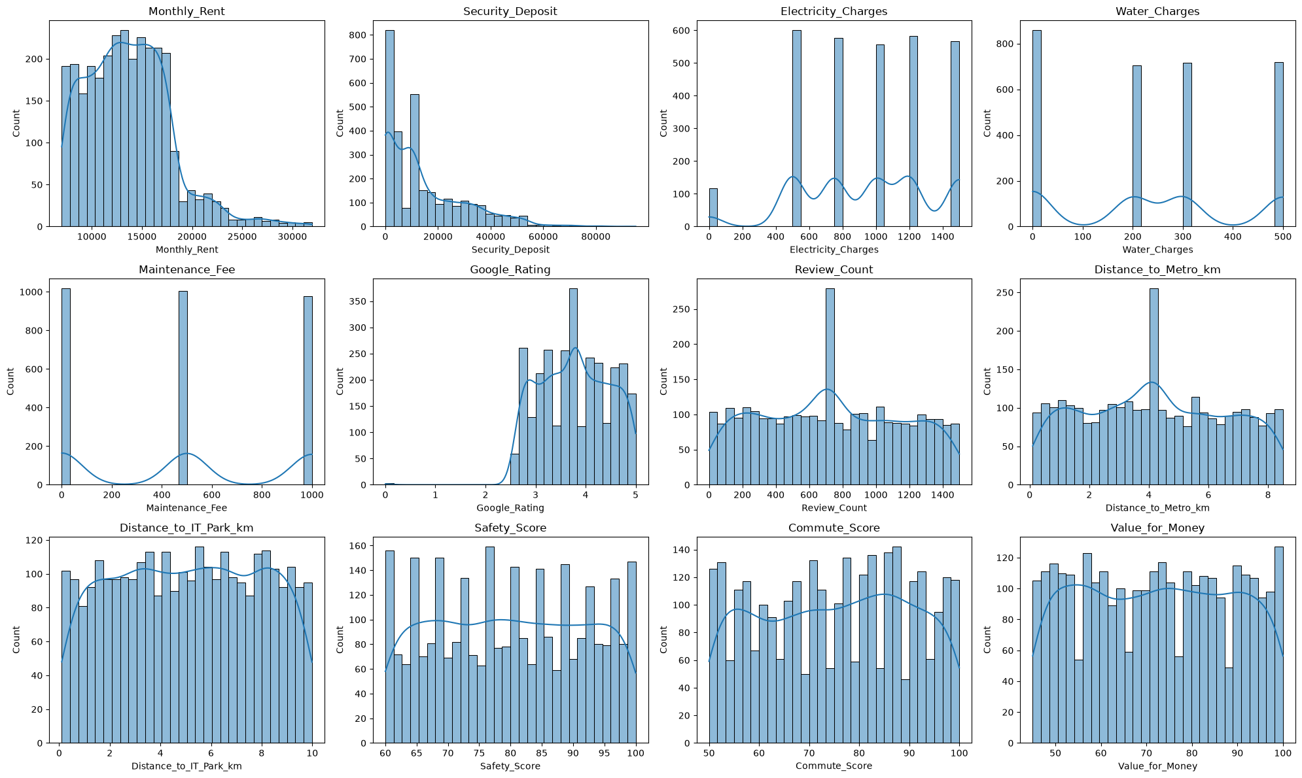
EXPLORATORY DATA ANALYSIS
EDA Overview
Most numeric columns (Water_Charges, Maintenance_Fee, Google_Rating, Review_Count, distances, Safety/Commute/Value scores) are close to uniform/normal with skewness near 0.
Monthly_Rent (sentinel excluded) is right-skewed (skew ≈ 0.84) — most listings cluster ₹7k–₹20k with a long tail toward ₹32k.
Security_Deposit is also right-skewed (skew ≈ 1.32) with a spike at 0 — many listings charge no deposit.
Gender, Room_Type, Food_Type, Occupancy_Status are fairly evenly distributed — no severe class imbalance.
Bengaluru PG Market Analysis
8

Slide 9
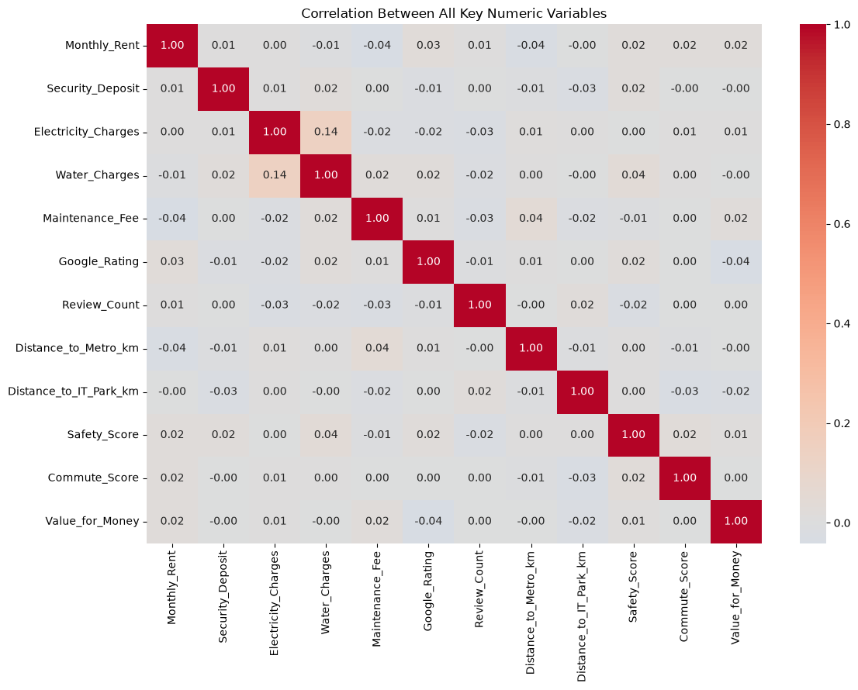
EXPLORATORY DATA ANALYSIS
Important EDA Analysis From the Notebook
Correlations across the board are very weak — the strongest is only Water_Charges–Electricity_Charges at r ≈ 0.15; everything else is below |0.05|.
Monthly_Rent shows almost zero correlation with Safety_Score, Commute_Score, Value_for_Money, Google_Rating, or distance to metro/IT park.
This weak-correlation finding directly motivated the modelling choice: rather than predicting rent from a single feature, listings were segmented using K-Means on multiple features together (Section 13).
Bengaluru PG Market Analysis
9

Slide 10
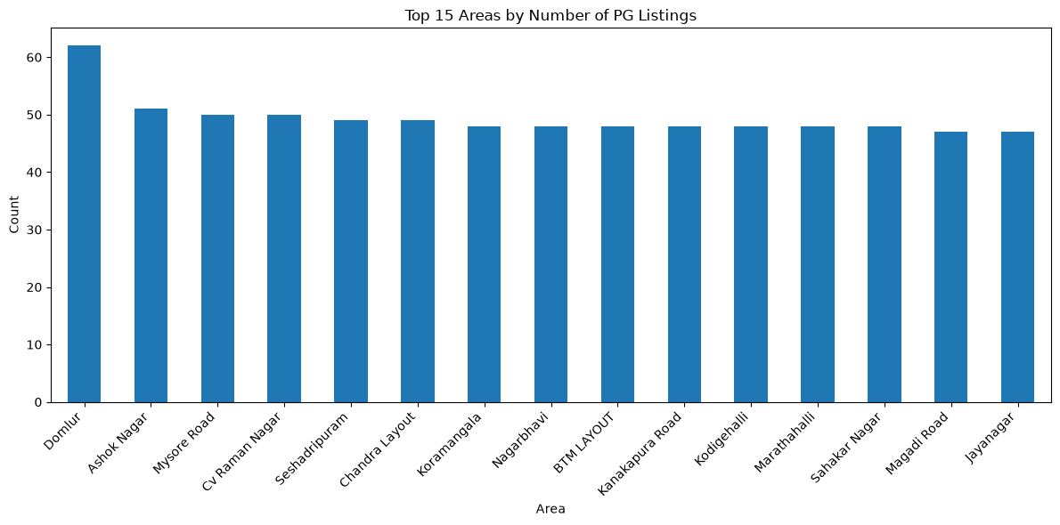
NOTEBOOK VISUALIZATION · GRAPH 1
Top 15 Areas by Number of PG Listings
Domlur leads with the most listings, followed by Ashok Nagar, Mysore Road, and CV Raman Nagar. Area is high-cardinality (66 unique localities) with a long tail.
Bengaluru PG Market Analysis
10

Slide 11
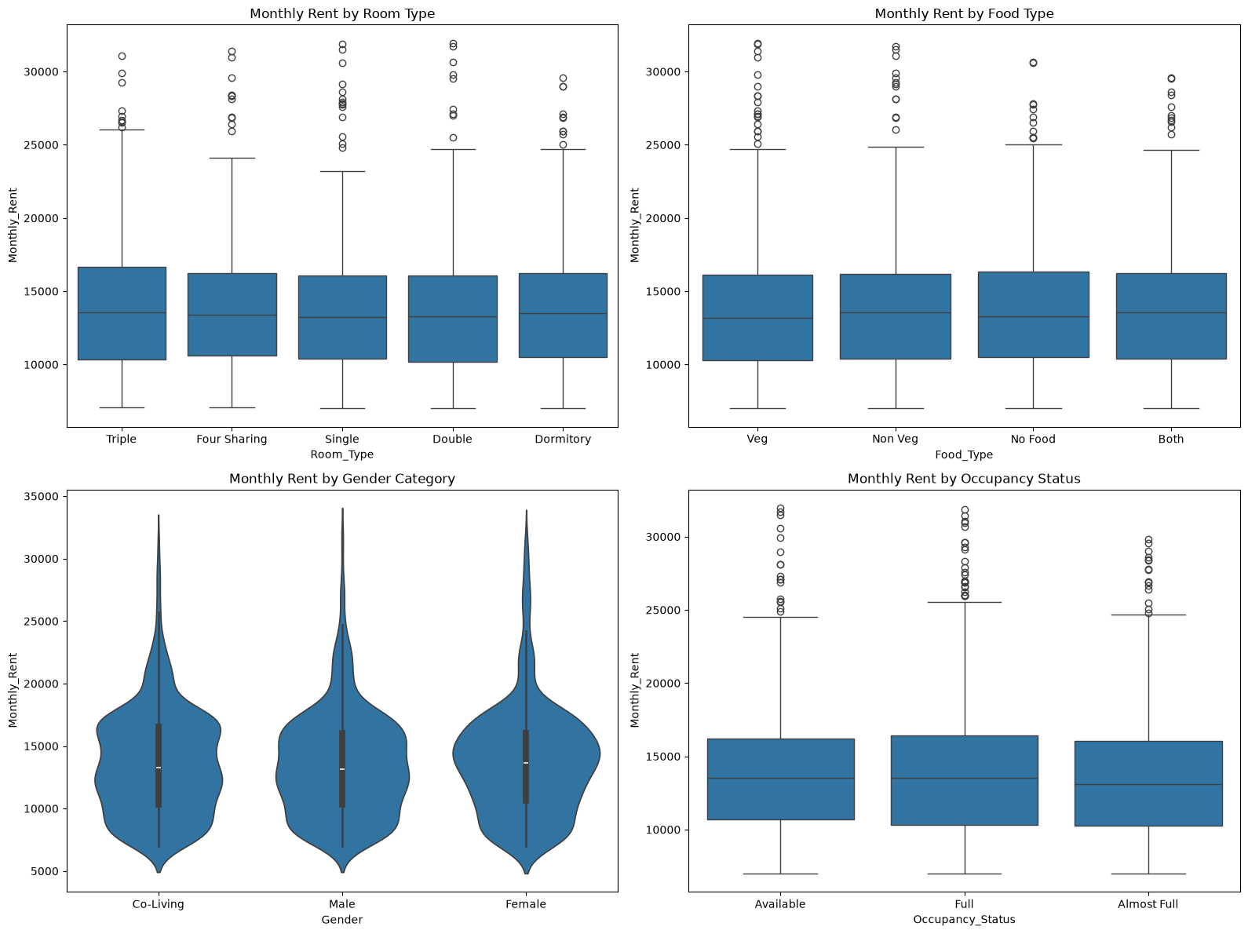
NOTEBOOK VISUALIZATION · GRAPH 2
Monthly Rent by Room Type, Food Type, Gender & Occupancy
Median rent is nearly identical (≈₹13,000–13,500) across Room_Type, Food_Type, Gender, and Occupancy_Status — none of these categorical fields meaningfully drive rent on their own.
Bengaluru PG Market Analysis
11

Slide 12
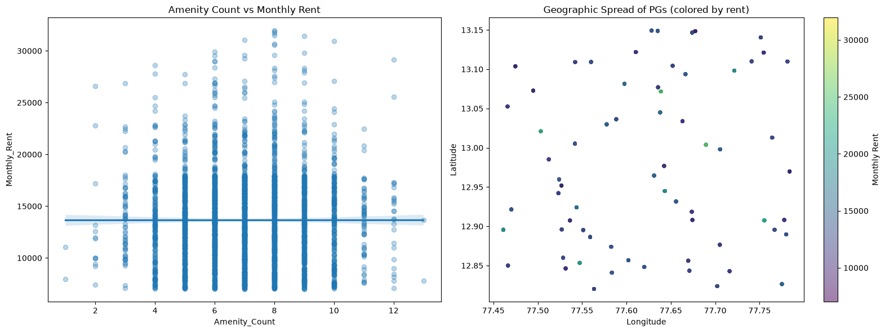
NOTEBOOK VISUALIZATION · GRAPH 3
Amenity Count vs Rent, and Geographic Spread
Amenity_Count shows ~0 correlation with rent, consistent with the correlation heatmap. The geographic scatter shows Latitude/Longitude carry useful spatial signal, supporting their use as clustering inputs.
Bengaluru PG Market Analysis
12

Slide 13
ML MODELING
Models Used: K-Means Clustering + Classification
Stage 1 — K-Means Clustering
Stage 2 — Classification
Unsupervised segmentation of PG listings into market groups.
Elbow method: no sharp elbow — inertia decreases smoothly across k = 2 to 10.
Silhouette score peaks at k = 2 (0.0801), then stays low and flat.
FINAL_K = 4 chosen: k = 2 only splits 'cheap vs expensive'; k = 4 is only marginally lower (0.0718) but gives four distinct, business-nameable segments.
Final model: silhouette = 0.0718, inertia = 23,552.3.
Supervised models trained to predict the K-Means cluster label from a listing's features — this is what powers the Streamlit app's instant prediction.
Three classifiers compared: K-Nearest Neighbours (k = 5), Logistic Regression (max_iter = 1000), and Random Forest (200 trees).
Best model: Logistic Regression, with 99.00% test accuracy (see Slide 15).
Bengaluru PG Market Analysis
13

Slide 14
ML MODELING
ML Data Preparation — Features & Target
Target Variable
Split & Preprocessing
Target: Cluster — the label produced by the K-Means model (4 classes: 0, 1, 2, 3).
Class balance: 513 / 868 / 778 / 833 listings — reasonably balanced (17%–29% share each), so accuracy is a meaningful metric here.
6 sentinel-rent rows (Monthly_Rent = 999999) excluded before modelling → 2,992 rows used.
Train/test split: 80/20, stratified by Cluster → Train (2,393, 11), Test (599, 11).
ColumnTransformer applied: RobustScaler on skewed cost columns, StandardScaler on the remaining numeric columns.
Same preprocessor fit on train, then applied to test — no leakage.
Feature Set (11 features)
Skewed (RobustScaler): Monthly_Rent, Security_Deposit, Total_Monthly_Cost
Standard (StandardScaler): Google_Rating, Review_Count, Distance_to_Metro_km, Distance_to_IT_Park_km, Safety_Score, Commute_Score, Value_for_Money, Amenity_Count
Engineered features: Amenity_Count (count of 14 amenity flags = 'Yes'); Total_Monthly_Cost (Monthly_Rent + Electricity_Charges + Water_Charges + Maintenance_Fee)
X shape: (2992, 11) y shape: (2992,)
Preprocessor, K-Means model, and best classifier saved as .pkl artifacts (joblib) for the Streamlit app.
Bengaluru PG Market Analysis
14

Slide 15
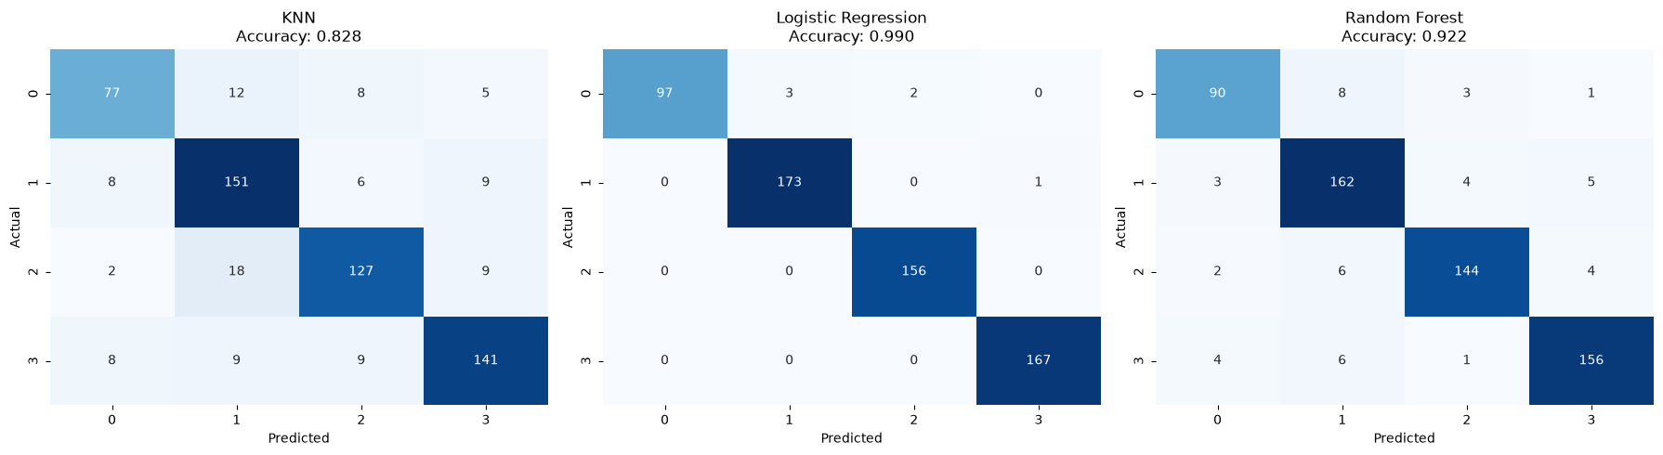
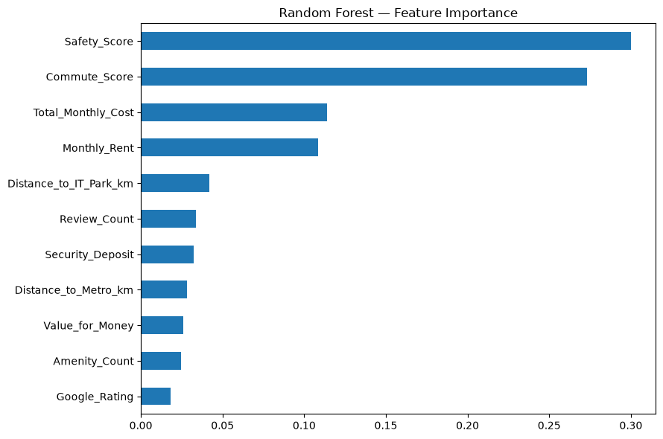
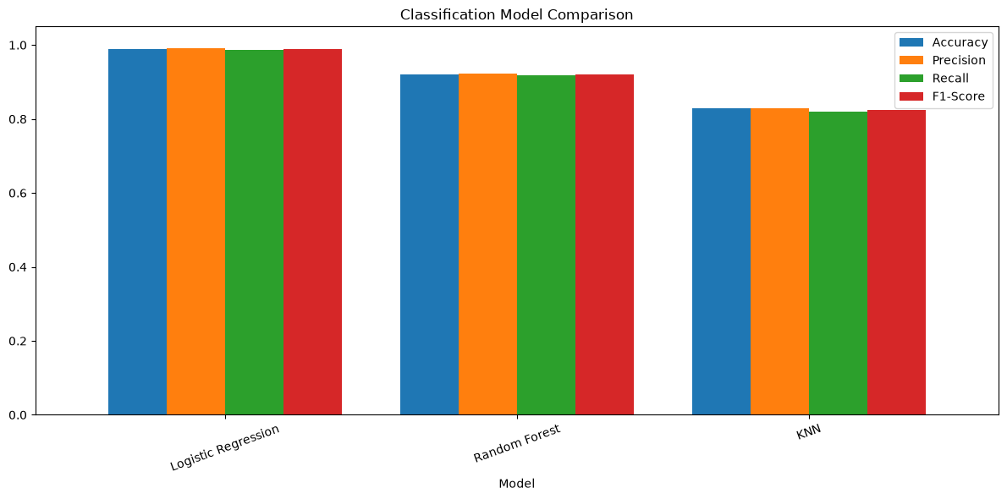
ML MODELING
Model Results & Evaluation
Model | Accuracy | Precision | Recall | F1-Score
Logistic Regression | 0.9900 | 0.9911 | 0.9863 | 0.9885
Random Forest (200 trees) | 0.9215 | 0.9216 | 0.9176 | 0.9194
K-Nearest Neighbours (k=5) | 0.8280 | 0.8279 | 0.8203 | 0.8234
Best model: Logistic Regression — 99.00% test accuracy (599 held-out listings). Errors concentrate between adjacent, similarly-priced clusters (see confusion matrix); the premium cluster is almost never confused with any budget cluster.
Confusion Matrices — Test Set (599 listings)
Bengaluru PG Market Analysis
15

Slide 16
TOOLS & TECHNOLOGY
Packages / Libraries Used
requirements.txt (Streamlit app)
Notebook Imports (analysis & modelling)
streamlit
pandas, numpy — data loading & manipulation
matplotlib, seaborn — EDA & result visualization
scikit-learn — RobustScaler, StandardScaler, ColumnTransformer, KMeans, PCA, train_test_split, KNeighborsClassifier, LogisticRegression, RandomForestClassifier, silhouette_score, confusion_matrix
joblib — saving preprocessor / kmeans_model / cluster_classifier as .pkl artifacts
pandas
numpy
plotly
scikit-learn
joblib
streamlit-option-menu
Bengaluru PG Market Analysis
16

Slide 17
FINDINGS
Key Project Insights
Rent, safety, and amenities are almost uncorrelated in this dataset — the strongest correlation among all numeric features is only r ≈ 0.15 (Water vs Electricity charges); rent itself correlates with nothing above |0.05|.
Because no single feature predicts rent, a multi-feature K-Means segmentation was more useful than any one-variable analysis — it produced 4 balanced, business-meaningful clusters (17%–29% share each).
Clusters are separated mainly by cost (rent/deposit/total monthly cost), Safety_Score, and Commute_Score — amenity counts barely vary between clusters.
The clustering itself is statistically weak (silhouette ≈ 0.07) but usable — consistent with the near-zero correlations found in EDA; overlap in the 2D PCA view (only ~23% variance explained) understates true separation in the full feature space.
Logistic Regression recovered the K-Means cluster boundaries almost exactly (99.0% accuracy, macro F1 = 0.989) — this gap over Random Forest and KNN indicates the cluster boundaries are close to linear.
Feature importance from the Random Forest model and the cluster profile both point to the same drivers: rent/cost, Safety_Score, and Commute_Score.
Classification errors that do occur are concentrated between adjacent, similarly-priced clusters rather than spread randomly — the premium cluster is almost never confused with a budget cluster.
Bengaluru PG Market Analysis
17

Slide 18
APPLYING THE FINDINGS
Business Ideas / Recommendations
1
For Prospective Tenants
2
For PG Operators
Since amenities and Google ratings barely move rent, tenants should compare listings within the same cluster (e.g. 'Budget – Safe & Well Connected') rather than assuming more amenities means higher cost, and prioritise Safety_Score / Commute_Score when narrowing choices.
Because rent shows almost no relationship with safety, commute, or amenities, operators in lower-cost clusters can differentiate on Safety_Score or Commute_Score — the two factors that do separate clusters — rather than competing purely on price.
3
Instant Segment Lookup
4
Where to Focus Data Effort
The saved pipeline (preprocessor + K-Means + Logistic Regression classifier) lets the Streamlit app tell an operator or tenant which of the 4 market segments a listing falls into instantly, using only rent, safety, commute, and related features.
Amenity flags and Google ratings contributed little to segmentation — future data collection could prioritise deeper safety/commute detail (e.g. verified transit times) since these are the features that actually separate the market.
Bengaluru PG Market Analysis
18

Slide 19
WRAP-UP
Conclusion
A raw, deliberately noisy dataset of 3,000 Bengaluru PG listings was cleaned to 2,998 usable records (2,992 used for modelling) through systematic handling of missing values, invalid entries, and inconsistent categories.
EDA showed rent, safety, and amenities are only weakly related to each other, which made a multi-feature K-Means segmentation more useful than single-variable analysis.
K-Means (k = 4) produced four balanced, business-nameable market segments — Premium – High Cost/High Safety, Budget – Safe & Well Connected, Affordable – Great Commute/Low Safety, and Affordable – Remote & Poorly Connected.
Among three classifiers compared, Logistic Regression was the clear best fit (99.00% accuracy, macro F1 = 0.989), confirming the cluster boundaries are close to linear.
The trained pipeline (preprocessor + K-Means + classifier) was saved with joblib and powers the accompanying Streamlit application for instant segment prediction on new listings.
Bengaluru PG Market Analysis
19

Slide 20
Thank You
Bengaluru PG Market Analysis — Questions & Discussion
Bhumi Paliwal • Gouri Shrimali • Mohit Mali • Tanishka Jain
Batch TechDS01

